Slide 1
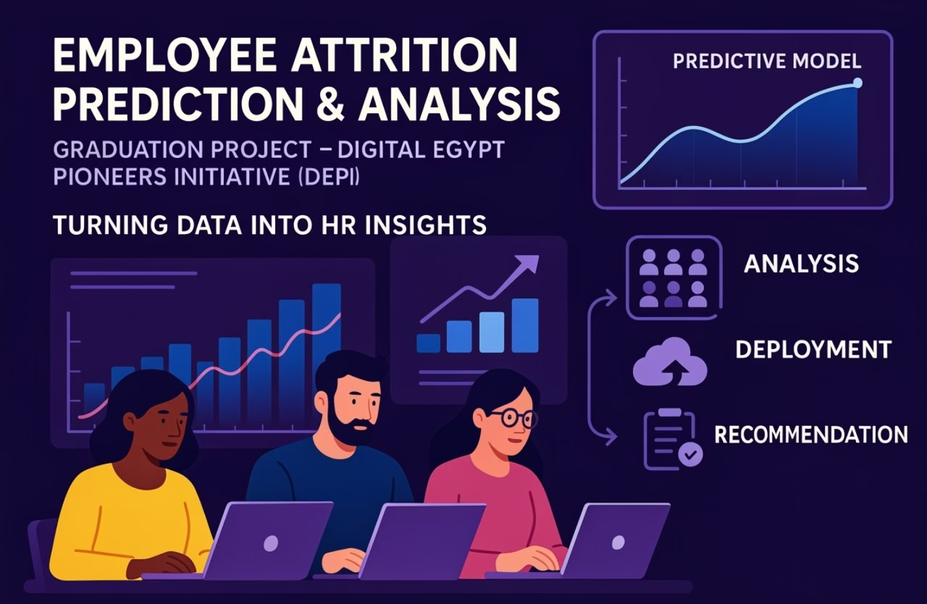

Slide 2

Meet the Team
1
Ibrahim Abdelsattar - Team Leader, (Milestone 1&2&5)
2
Ali Madian - (Milestone 1&2)
3
Ahmed Tarek - (Milestone 3)
4
Reem Ashraf - (Milestone 3)
5
Yousif Saad - (Milestone 4)
6
Mohamed Abd el-meged - (Milestone 4)

Slide 3






Agenda Overview
Project Timeline, Introduction and Objectives:
Define scope and goals for attrition prediction.
Data Analysis and Preprocessing:
Explore data quality and preparation steps.
Modeling and Evaluation:
Build and assess predictive models.
Deployment and MLOps:
Strategies for operationalizing the model.
Recap, Q&A, and Conclusion:
Summarize findings and address questions.

Slide 4




Project Timeline
Data Collection and EDA
Duration: 1 week
Gather data and perform initial exploration to understand patterns.
Data Preprocessing and Feature Engineering
Duration: 1 week
Clean, transform data, and create meaningful features for modeling.
ML Model Development and Optimization
Duration: 2 weeks
Train models, tune hyperparameters, and improve predictive accuracy.
MLOps and Deployment
Duration: 2 weeks
Automate deployment and monitoring for sustainable model operation.

Slide 5






Project Introduction and Objectives
Employee turnover remains a significant concern for organizations worldwide. Recent data indicates that the average global employee turnover rate is approximately 20%, with certain industries, such as retail, hospitality, and technology, experiencing even higher rates. Notably, voluntary departures constitute about 70% of these turnovers, often driven by factors like burnout, limited career advancement, and dissatisfaction with work-life balance. Keevee
This high turnover not only disrupts organizational continuity but also incurs substantial costs. Estimates suggest that replacing an employee can cost between 33% to over 200% of their annual salary, depending on the role and industry. ​​Keevee
🎯 Project Objectives
Determine
Analyze
2
key factors contributing to employee turnover within the organization.
employee data to identify patterns and trends associated with attrition.
1
Understand
the underlying reasons behind employees' decisions to leave.
5
Provide
actionable insights and recommendations to enhance employee retention strategies.
Develop
4
predictive models to assess the likelihood of employee attrition.

Slide 6
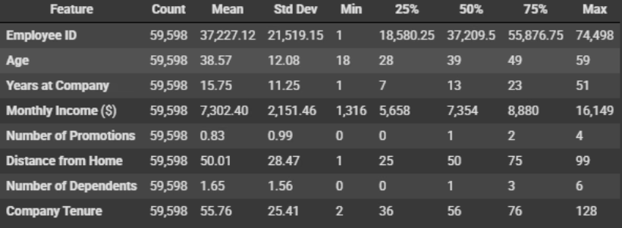
Data Overview & Wrangling
Dataset Summary
Data Wrangling Steps
59,598 employee records
No missing values
Features: Age, Gender, Monthly Income, Years at Company,...etc
No duplicates found
Verified data types, removed irrelevant columns like Employee ID

Slide 7
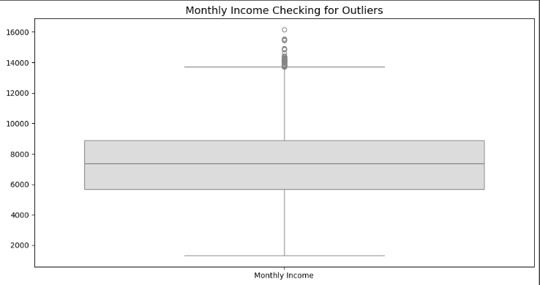
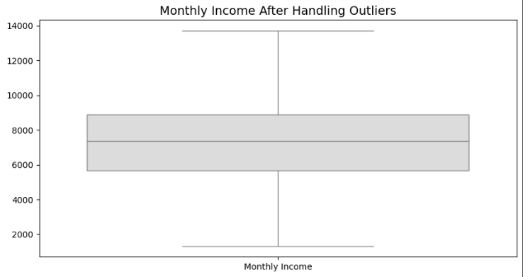
Handling Outliers
Winsorized 50 outliers in Monthly Income

Slide 8
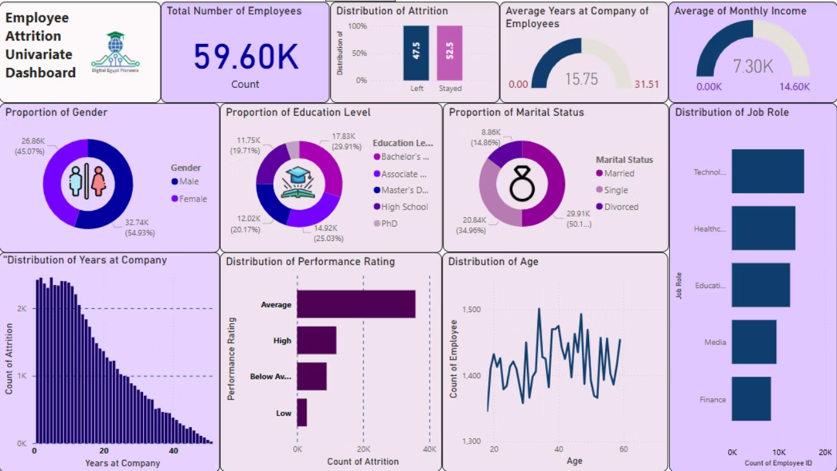
Exploratory Data Analysis
Univariate Analysis

Slide 9
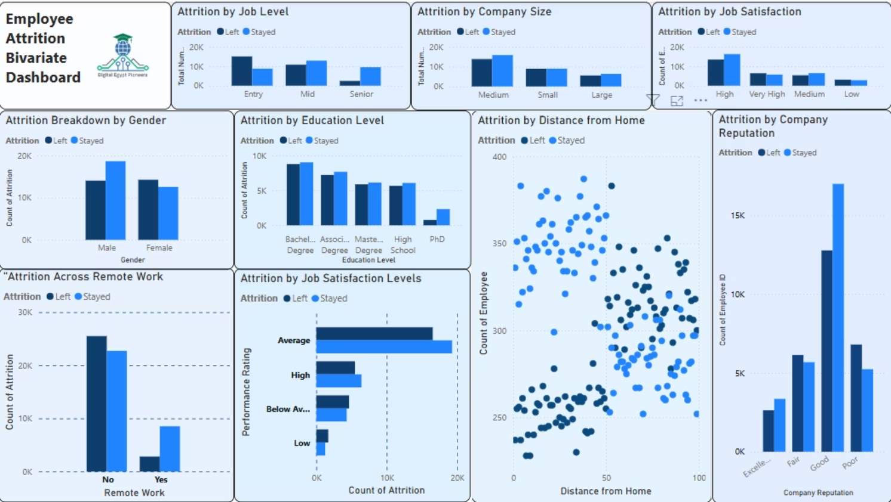
Bivariate Analysis

Slide 10

Top Strategic Recommendations to Reduce Attrition
Onboarding & Mentorship
Boost Job Satisfaction
Flexible Work Policies
Performance Coaching
Offer choice between office, hybrid, and remote work, especially for distant employees.
Provide strong training and mentoring for new hires during the first 6 months.
Conduct surveys and implement recognition programs and clear career paths.
Follow up with average-rated employees and provide personalized coaching.
Retention Plan
Develop tailored support plans for mid-sized teams and branches.

Slide 11
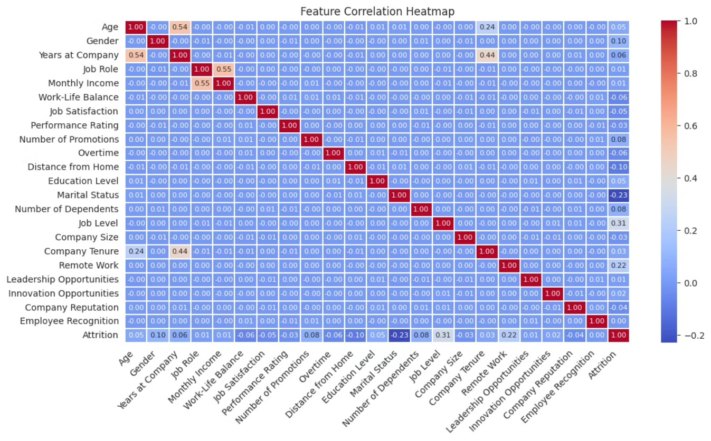
Multivariate Analysis

Slide 12

🔍 Insights from the Correlation Heatmap
📌 Attrition Correlation
💡 Strong Feature Interrelationships
Job Level shows a moderate negative correlation with Attrition (-0.31), meaning employees at higher job levels are less likely to leave.
Performance Rating is strongly negatively correlated with both:
Salary_Performance_Ratio (-0.76)
Remote Work (0.22) and Salary_Performance_Ratio (0.21) have positive correlations, indicating these employees are slightly more likely to leave.
Income_JobLevel_Ratio (-0.76)
Job Satisfaction and WorkLife_Satisfaction_Score are strongly positively correlated (0.76).
Performance Rating (-0.03) and Income_JobLevel_Ratio (-0.22) show negative relationships, implying that better-rated or more fairly compensated employees are less likely to leave.
📎 Other Observations
Marital Status has a moderate negative correlation with Attrition (-0.23), indicating married employees are less likely to attrition.
Tenure_Group and Years at Company are moderately correlated (0.49).
Monthly Income correlates moderately with:
Job Role (0.55)
Salary_Performance_Ratio (0.57)
Income_JobLevel_Ratio (0.56)
💬 Suggested Talking Points
Focus on Job Level, Remote Work, and Compensation Ratios as important features for attrition prediction.
Consider dropping one of the correlated salary metrics to avoid redundancy.
Support retention by improving compensation fairness and remote work policies.
Marital Status might serve as a relevant demographic indicator in attrition risk analysis.

Slide 13
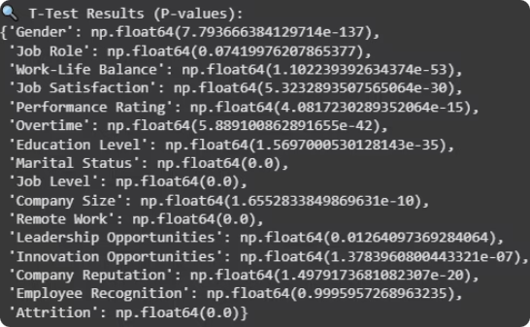
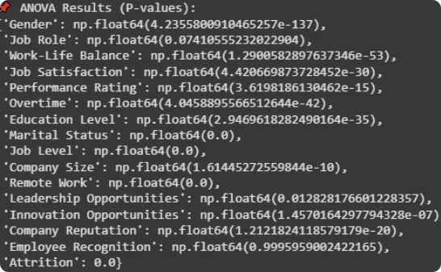
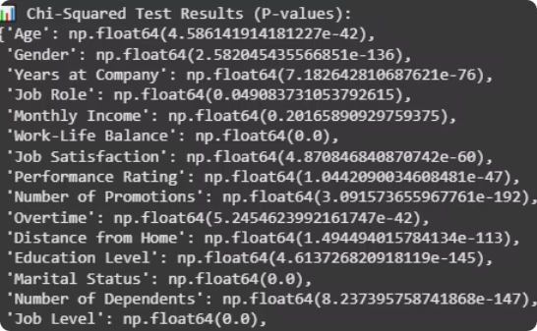
Advanced Data Analysis & Feature Selection
T-Test Insights
ANOVA Findings
Chi-Squared Test
Significant features include Gender, Work-Life Balance, Job Satisfaction, and Job Level.
Confirms impact of Marital Status, Performance Rating, and Remote Work on attrition.
Age, Number of Promotions, and Company Reputation strongly relate to attrition likelihood.

Slide 14
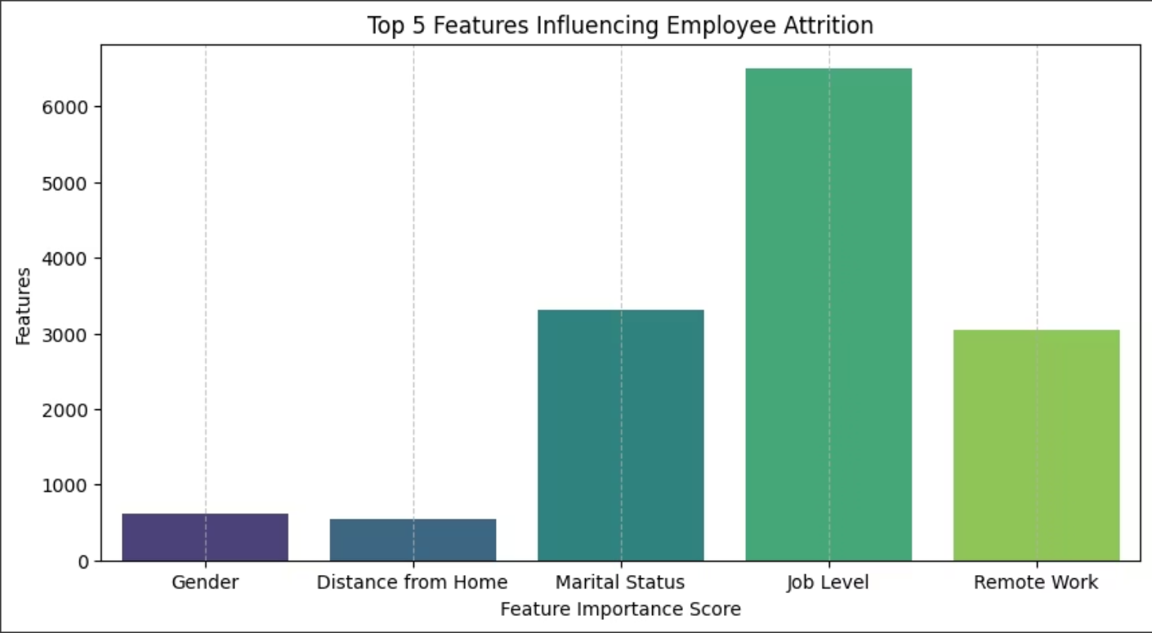
🚀 Top 5 Selected Features (SelectKBest - ANOVA F-test):
['Gender', 'Distance from Home', 'Marital Status', 'Job Level', 'Remote Work']

Slide 15

Data Preparation: Encoding & Normalization
Encoding Techniques
Normalization
Purpose
Label Encoding for binary columns like Gender and Remote Work
Applied to numerical features to ensure compatibility with machine learning algorithms.
Prepare data for effective model training and accurate predictions.

Slide 16

Machine Learning Model Development
Data Splitting
Employee attrition impacts productivity and organizational stability significantly. Developing a predictive model helps identify at risk employees early.
80% training and 20% testing sets ensured robust evaluation.
Our approach leverages historical data to train algorithms that forecast attrition trends. This process enhances proactive retention strategies.
Handling Imbalance
Applied SMOTE to balance classes at 47% attrition rate, generating synthetic samples for the minority class.

Slide 17
Model Selection
Logistic Regression: A straightforward and effective linear model commonly used for binary classification tasks.
Random Forest & Extra Trees: Ensemble methods that combine multiple decision trees to enhance predictive accuracy and robustness.
XGBoost, Gradient Boosting, LightGBM, & CatBoost: State-of-the-art boosting algorithms designed for high performance and speed in complex datasets.
K-Nearest Neighbors (KNN): A non-parametric, instance-based approach that excels at modeling non-linear decision boundaries.
Decision Tree: An interpretable model offering transparent decision-making through hierarchical decision paths.
Bagging & AdaBoost: Ensemble techniques that improve stability and reduce variance by combining multiple weak learners.
All models were thoroughly evaluated using key performance metrics to identify the most suitable candidates for deployment.

Slide 18
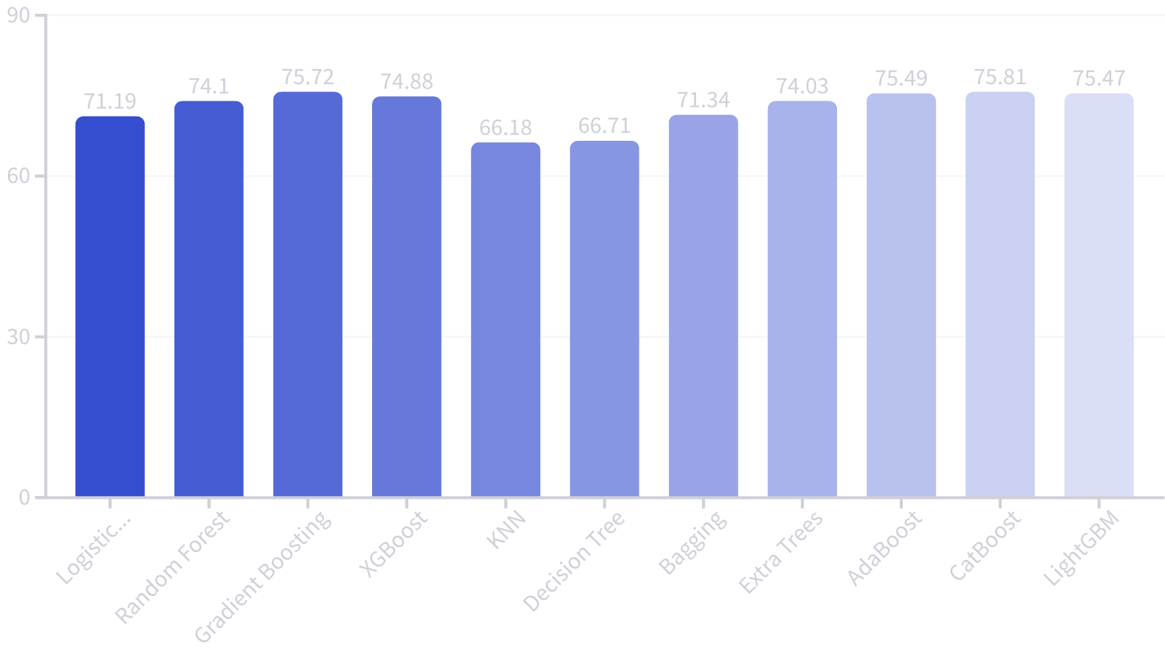
Baseline Training Model Accuracy
CatBoost achieved the highest baseline accuracy at 75.81%. It excels in handling categorical features automatically and offers robust performance on complex datasets.

Slide 19
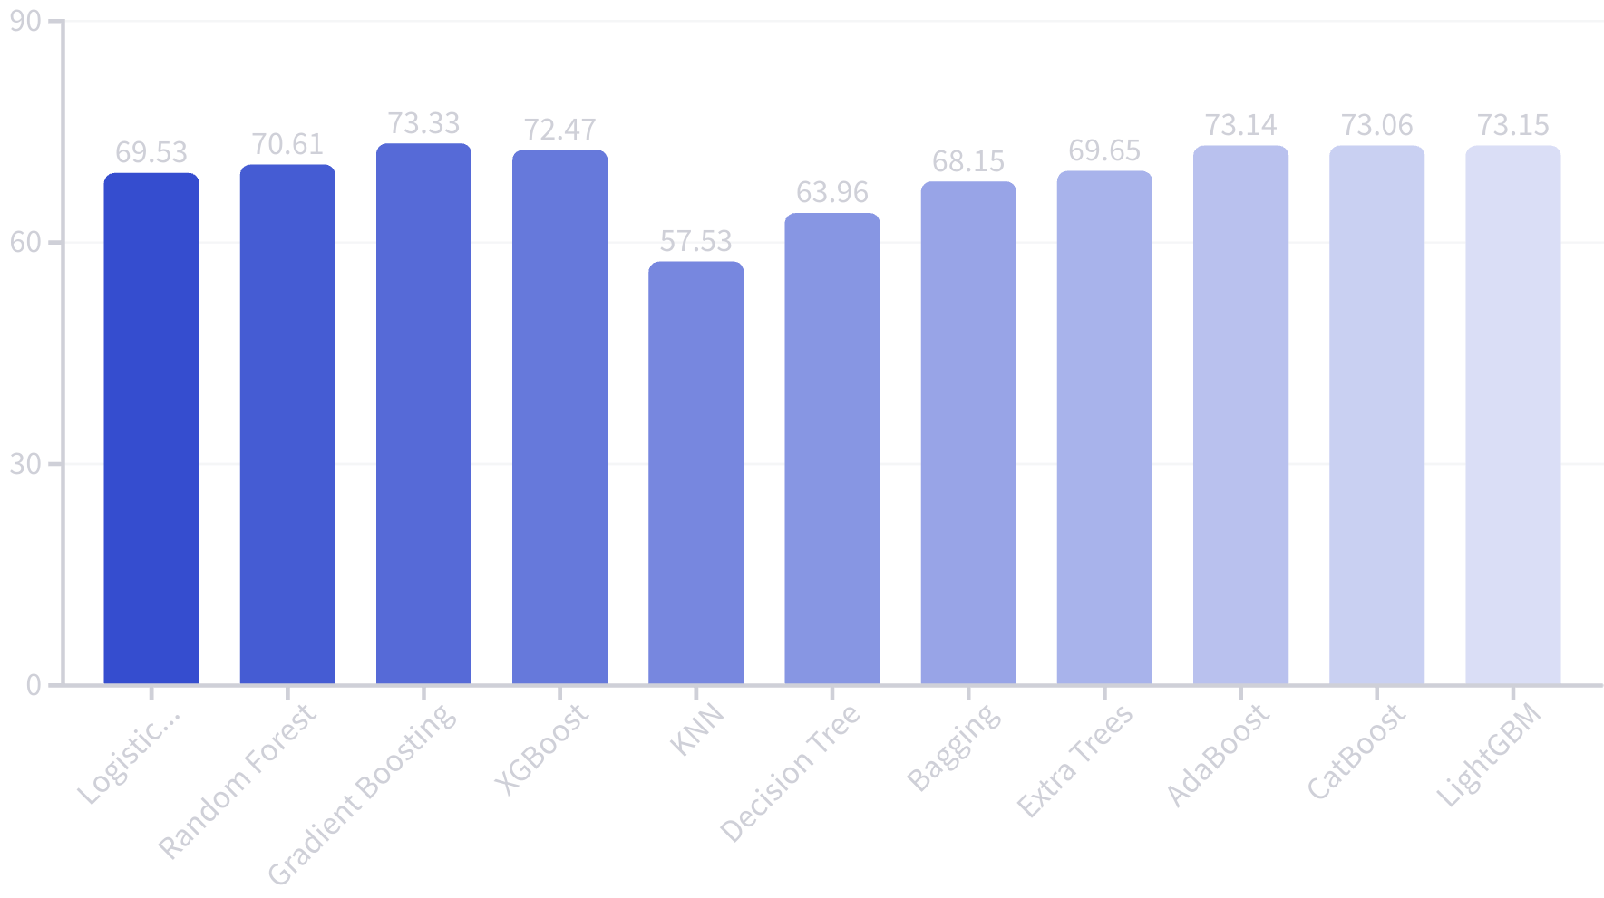
Minimal Preprocessing Baseline Model Performance
The highest accuracy was achieved by Gradient Boosting at 73.33%.
Gradient Boosting is a powerful ensemble method that builds models sequentially to correct errors of previous models, improving prediction accuracy.

Slide 20
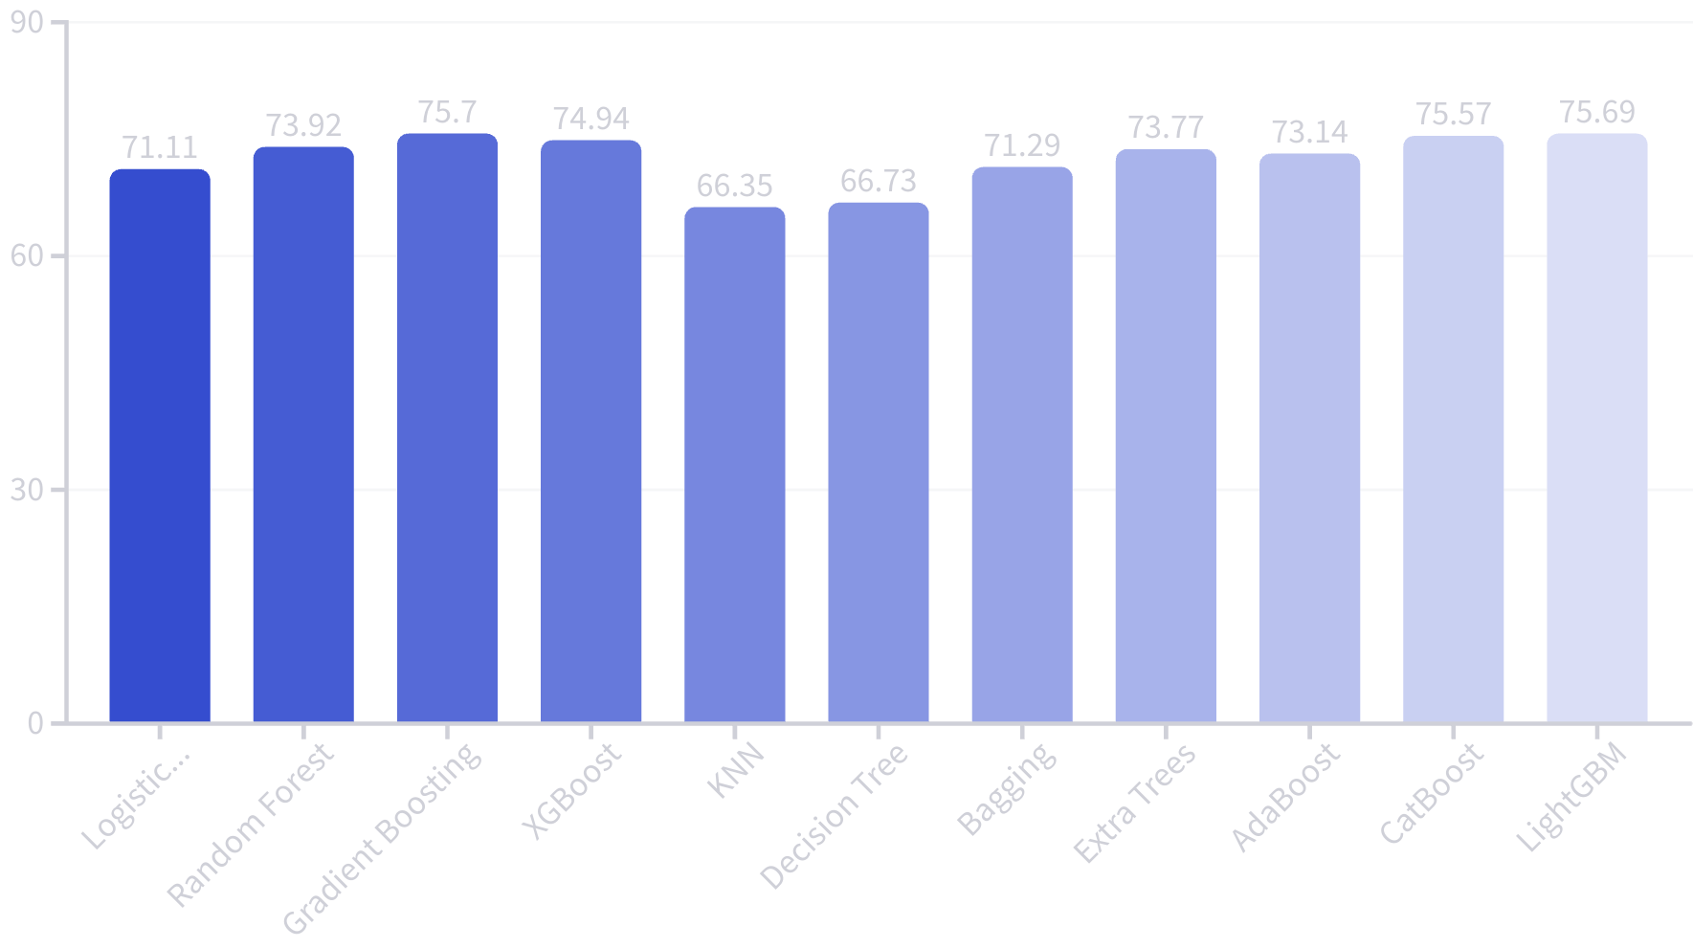
Model Performance After Feature Engineering
Gradient Boosting leads with 75.70% accuracy after feature engineering. It effectively corrects errors from prior models and adapts well to complex datasets.

Slide 21
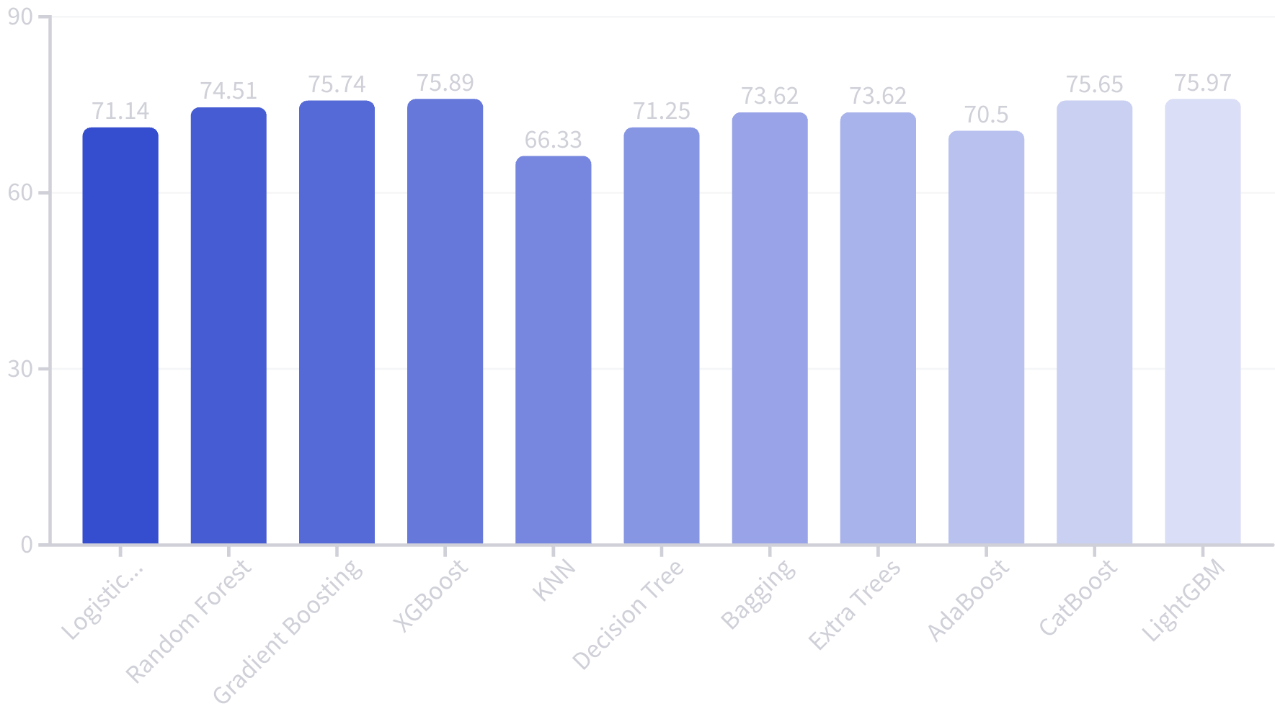
Fully Optimized Model Performance
LightGBM achieved the highest accuracy with 75.97%. It offers exceptional speed and efficiency.
LightGBM automatically handles categorical features and scales well on large datasets.

Slide 22
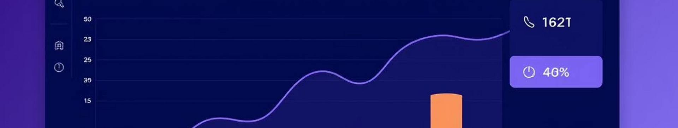
Results and Strategic Recommendations
Key Findings
Recommendations
The LightGBM model showed top performance with high prediction accuracy.
Enhance salary and benefits to boost satisfaction.
Strengthen work environment with promotion and growth.
Attrition Drivers
Leverage data analytics to predict and reduce attrition.
Low job satisfaction, below-market salaries, and long hours without promotion.

Slide 23
Employee Attrition MLOps & Deployment
MLflow:
1
Used for experiment tracking and model registry.
Initialized experiments with mlflow.set_experiment().
Logged model parameters (e.g., num_leaves, learning_rate for LightGBM) and metrics (accuracy, precision, recall, F1-score).
2
Model Deployment
Flask API:
Enabled comparison and selection of the best-performing model via MLflow’s UI.
A RESTful API built with Flask accepts JSON-formatted employee data and returns predictions.
The model is loaded using mlflow.sklearn.load_model().
Monitoring and Retraining
3
Designed for integration into backend systems.
We implemented real-time model monitoring using Prometheus and MLflow to continuously track performance metrics like accuracy, precision, and predicted attrition rate, ensuring early detection of performance drops or business risk.
We implemented an automated model comparison pipeline that retrains the model, evaluates its performance, and only deploys it if it outperforms the current production model, ensuring consistent improvement."

Slide 24
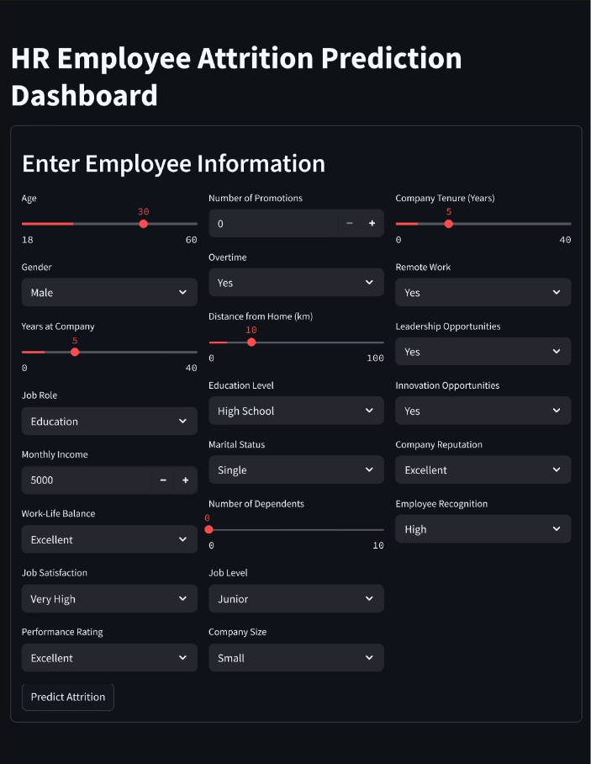
Streamlit Dashboard:
A user-friendly interface for HR personnel to input employee data and receive real-time predictions and explanations.
Ideal for business-facing applications and demonstrations.

Slide 25
Recap and Conclusion
Project Summary
Key Insights
Built an attrition prediction model combining feature engineering and hyperparameter tuning.
Low job satisfaction, pay gaps, and promotion delays are major attrition drivers.
LightGBM emerged as the most accurate and robust model for deployment.
Data-driven recommendations improve retention by targeting these key factors.

Slide 26

Q&A
Feel free to ask questions to deepen understanding or explore insights.

Slide 27
Thanks for Your Time
We appreciate your attention and engagement throughout this presentation.
Please reach out with any follow-up questions or discussion points.

